Slide 1
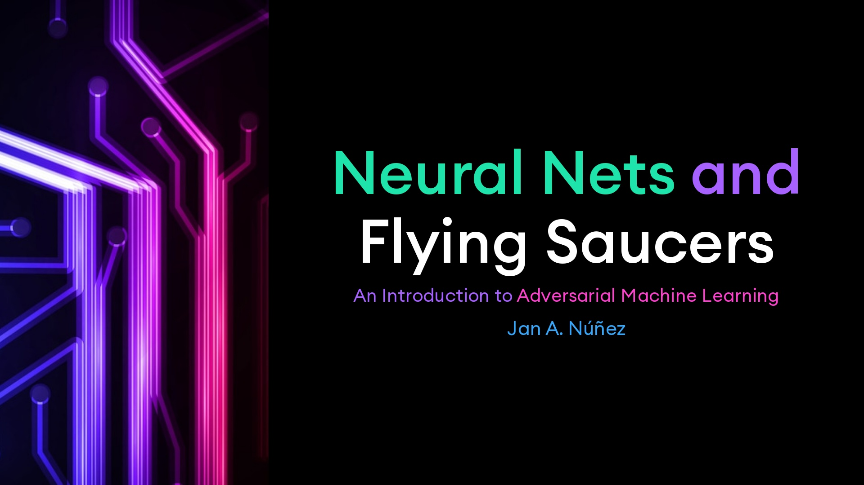
Notes:
These are notes.

Slide 2
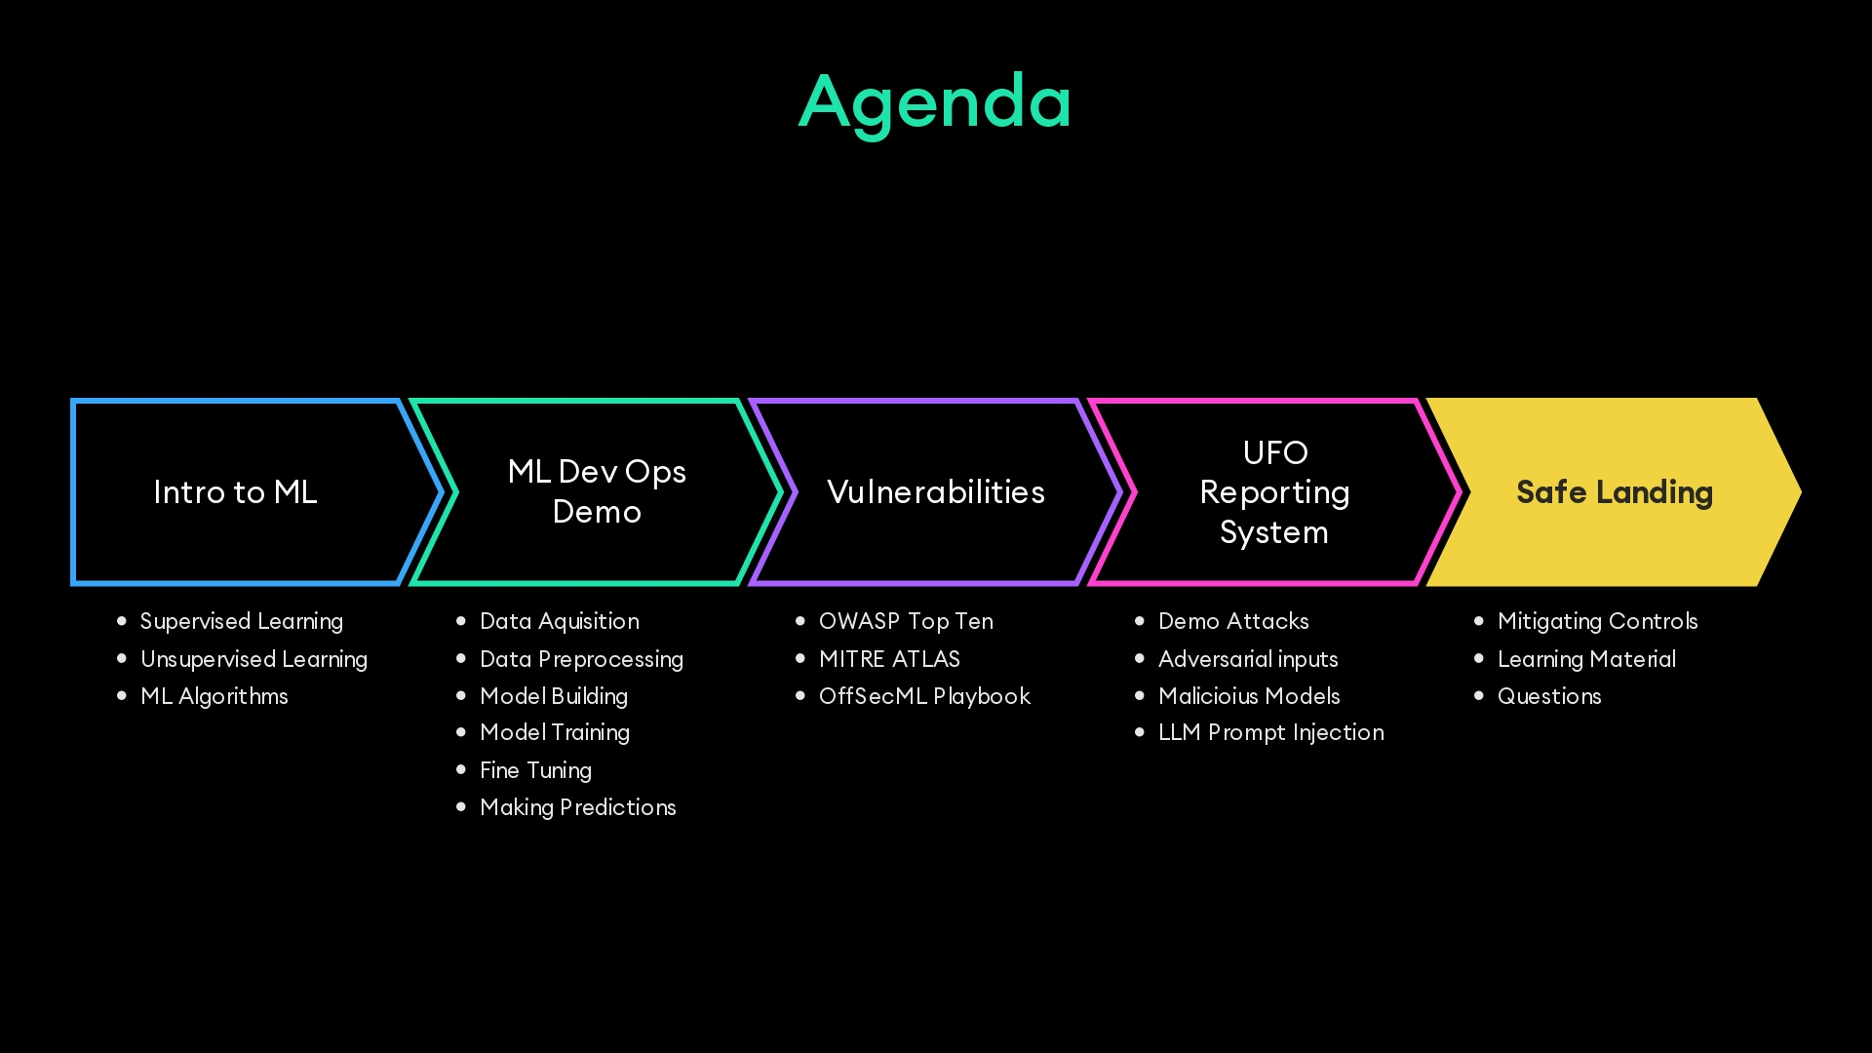

Slide 3
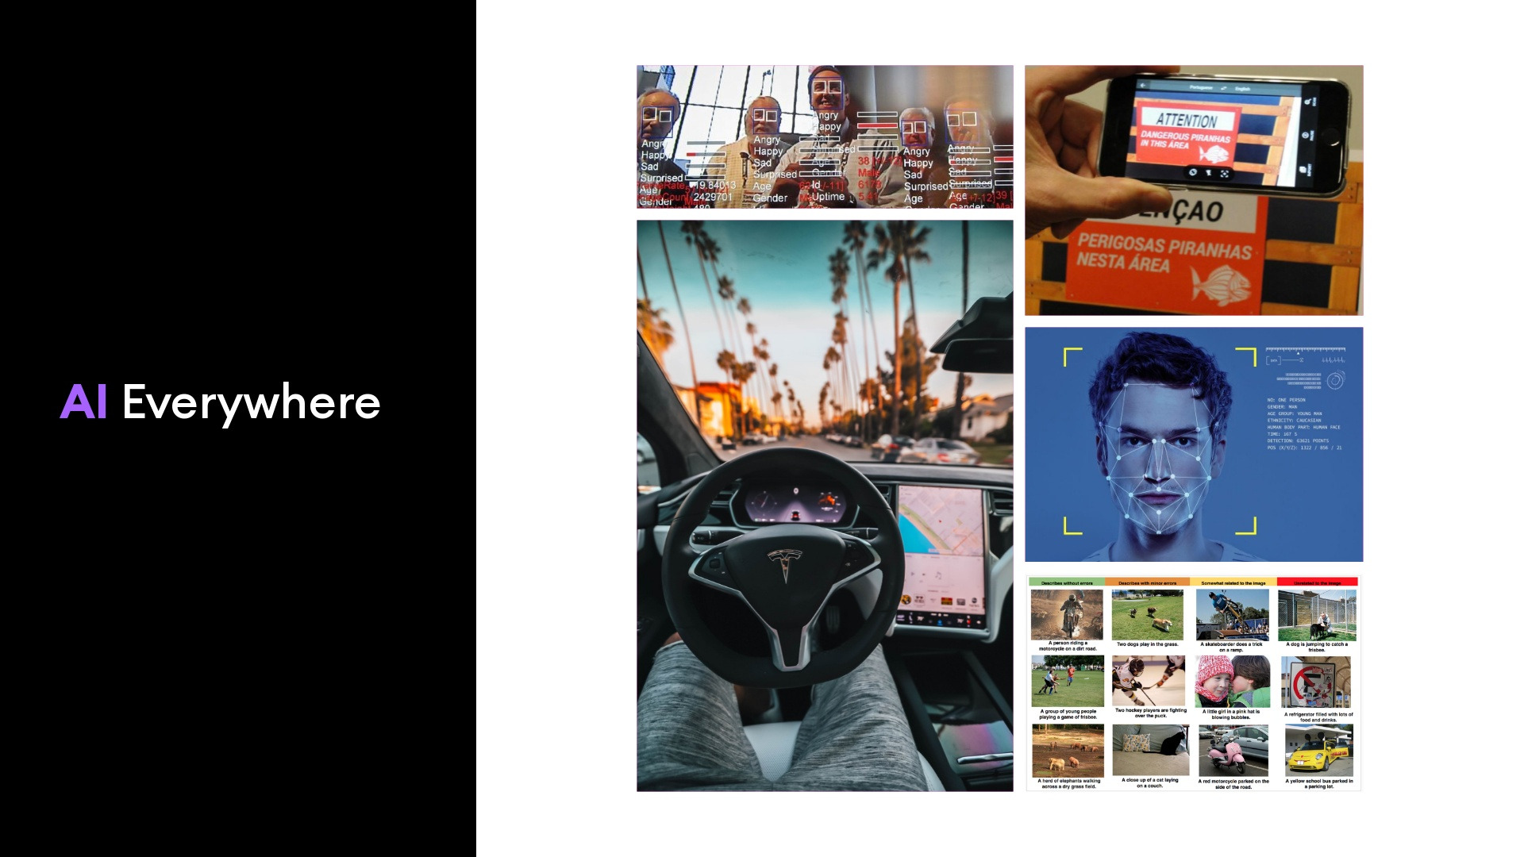
Notes:
- Facial Recognition- Sentiment Analysis- Image Classification- Large Language Models

Slide 4
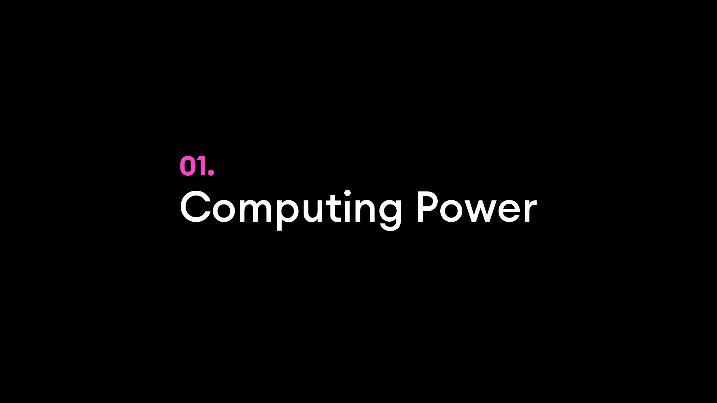
Notes:
Lower barrier of entry...CPUs were 2^20s of times too slowParallel processing/algorithmsGPUs + OpenCL/CUDAFPGAs, custom hardware

Slide 5
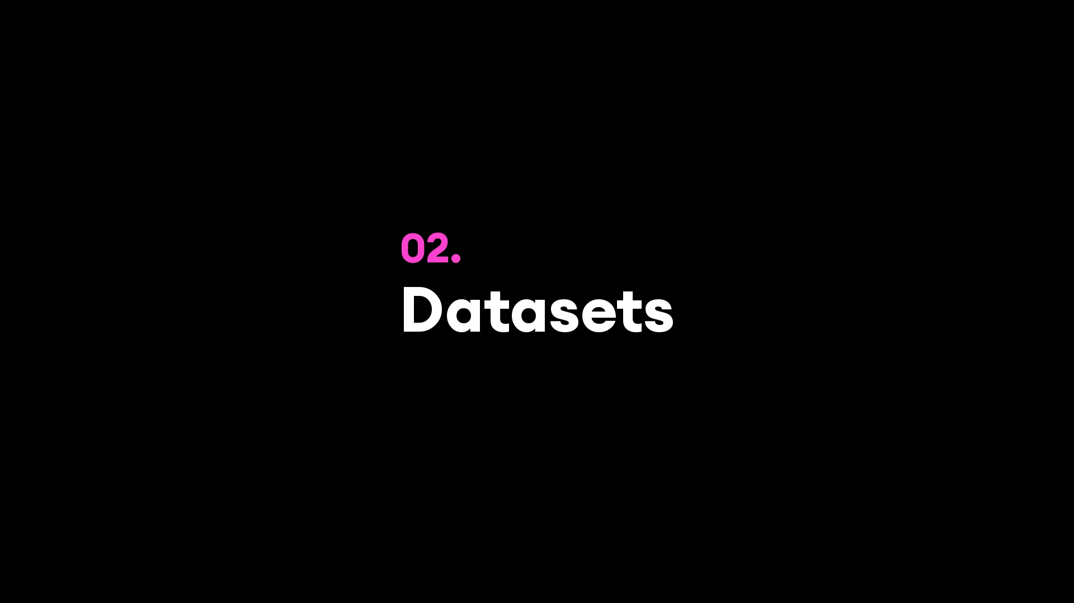
Notes:
Massive data sets: Google, FB, Baidu, …Standardized data sets

Slide 6
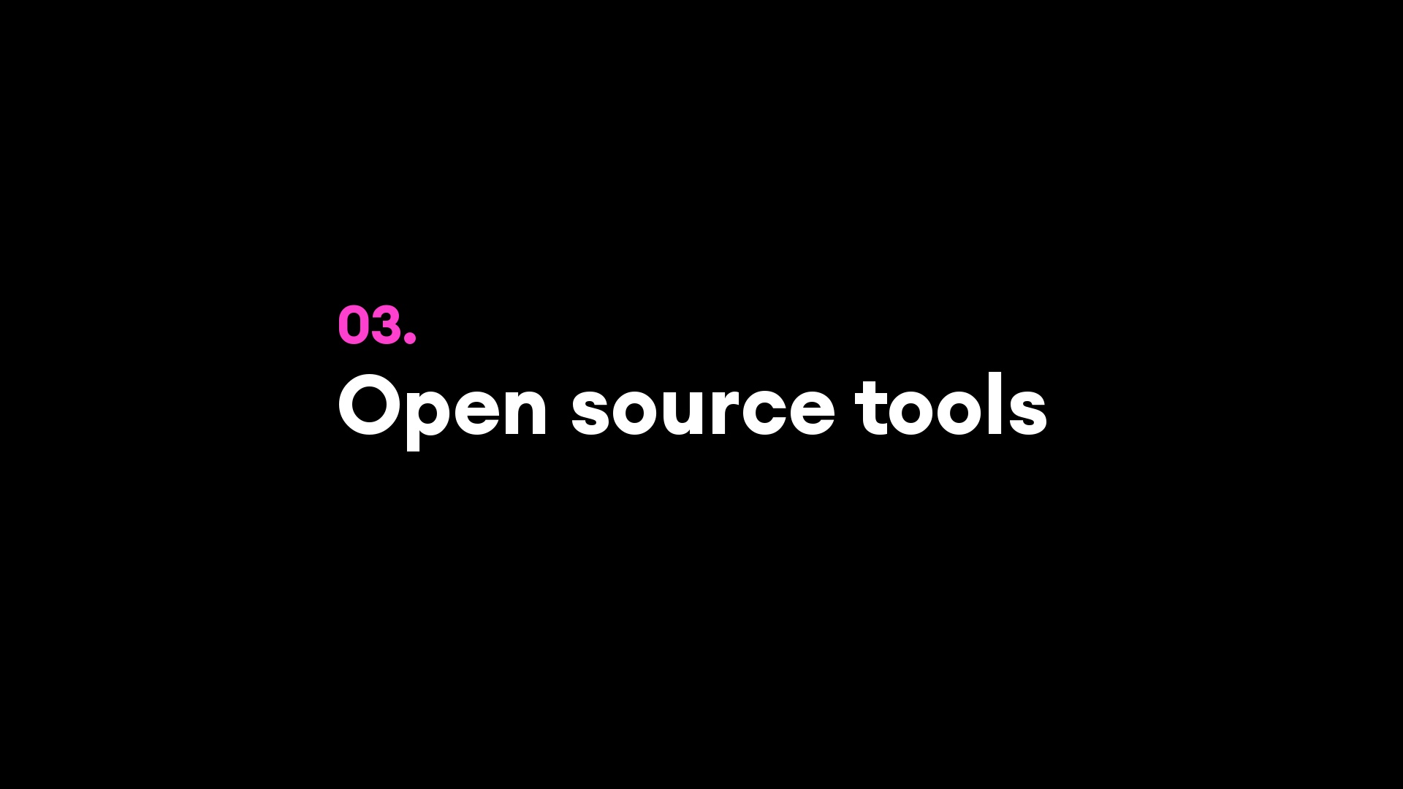
Notes:
TensorFlowHuggingface.coTheanoTorchCaffeDeepLearning4JAmazon Machine LearningAzure ML StudioCaffeScikit-Learn

Slide 7

Notes:
World's most capable models available at just cents a query

Slide 8
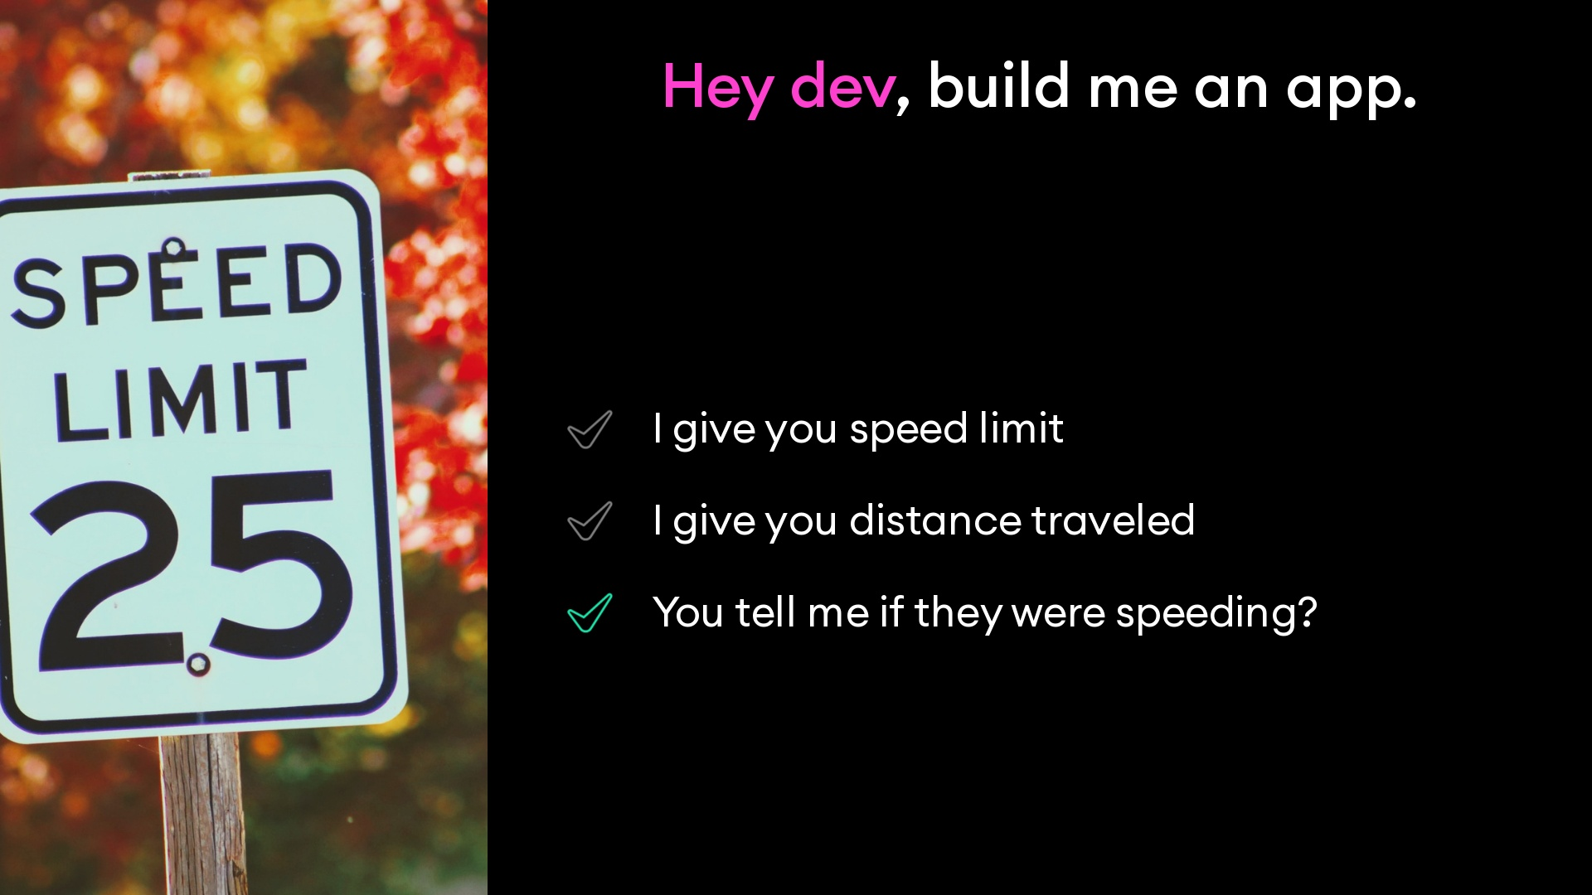
Notes:
How does this all work?developer asked to write a program detect if someone was going over the speed limit

Slide 9
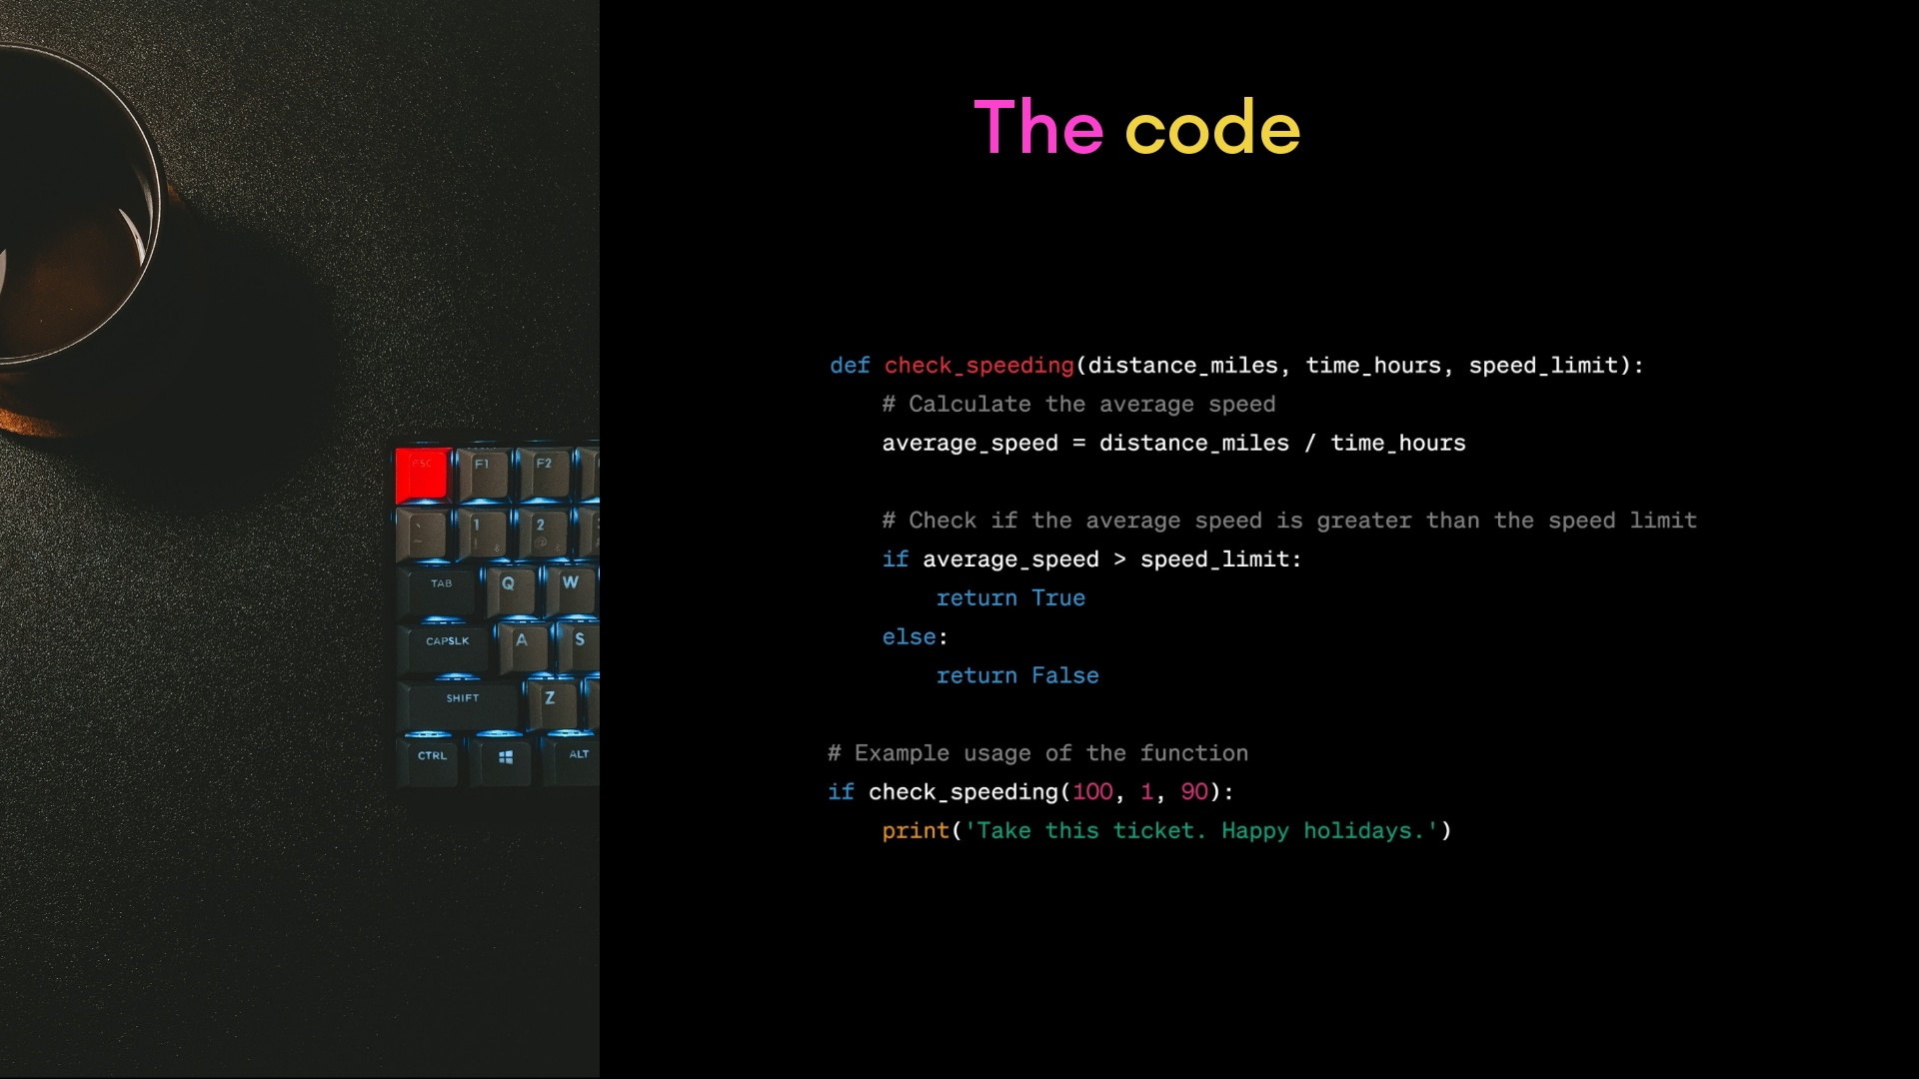
Notes:
they would probably come up with something like this.easy to understrand no programming experience requiredstraightforward programing taskclear function/algorithm for deciding whether the are classified as true or false

Slide 10
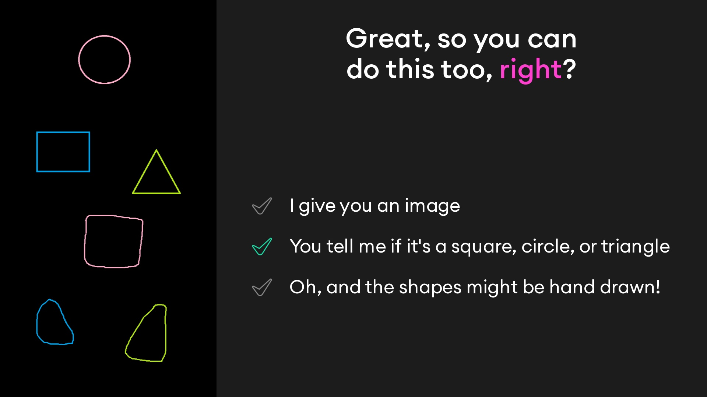
Notes:
Now what if we asked the programmer to write a function that can classify any image as a circle, triangle, or square?They could perhaps start by defining rules, like counting three sides for a triangle, look for round edges for a circleNow what if the shapes were hand drawn? Is this a circle, or a square?

Slide 11
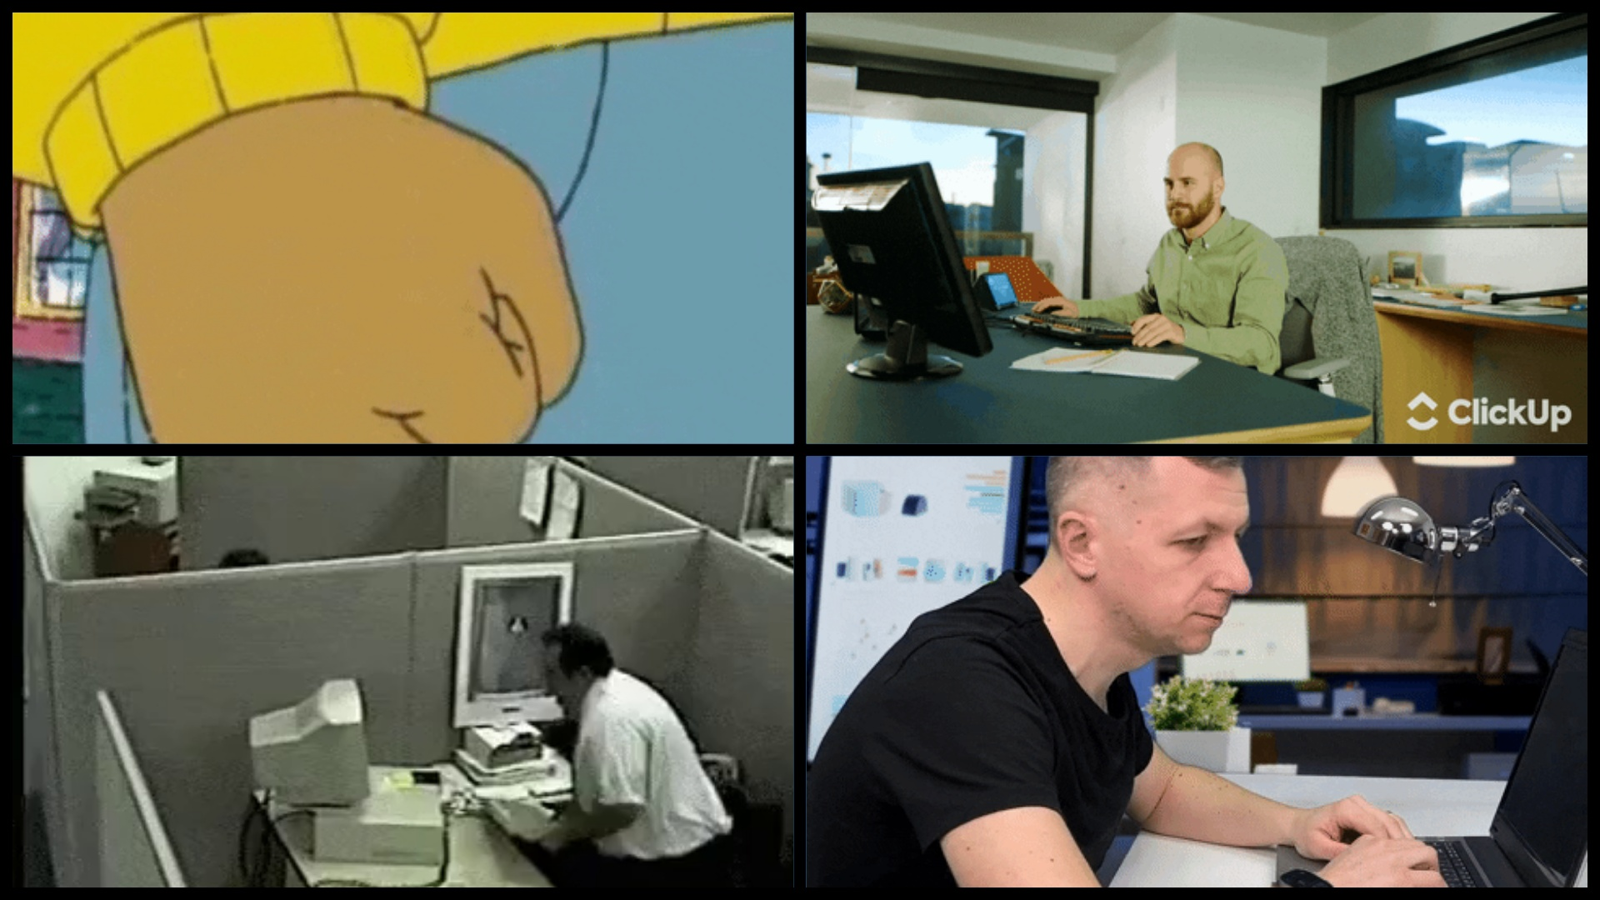
Notes:
They would quickly realize that writing a program, or a function, to perform this task is unfeasibleWe can make an accurate decision on whether a hand drawn shape is a squarebut we couldnt even begin to describe howand if cant describe it, we likely wont be able to describe itThis is a problem tailor made for machine learning

Slide 12
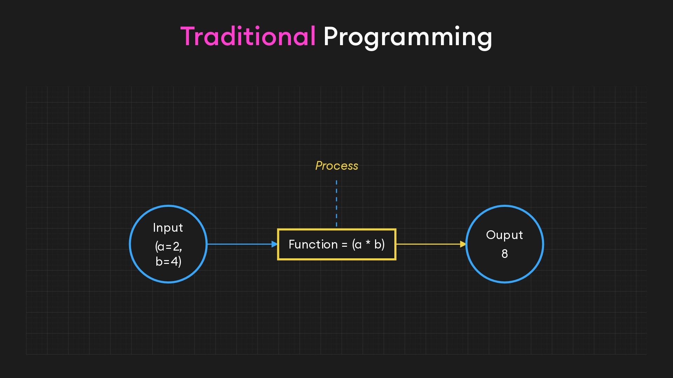
Notes:
Becaused whereas in traditional programmingwe define the process (a function) to turn inputs into outputs

Slide 13
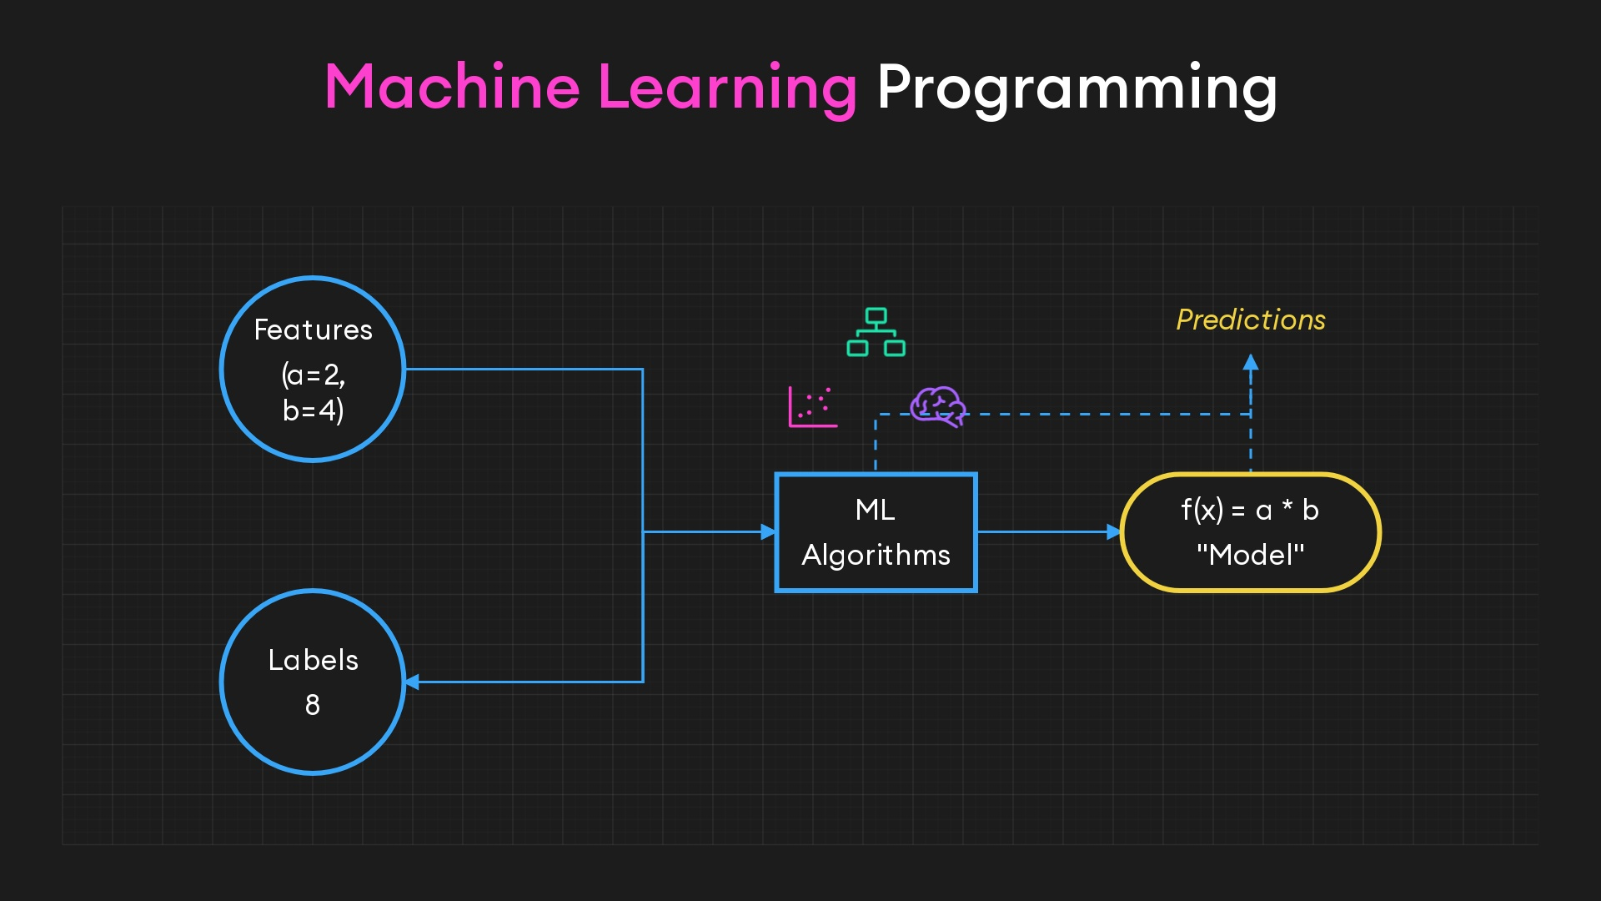
Notes:
Machine learning uses inputs (and sometimes outputs) to derive the process itselfThis process is known as a model, which can then be applied to new, unseen data to make predictionsEssentially, machine learning algorithms act as universal creators of functionsProvide inputs and expected outputs (when available)Algorithms learns the relationships between our data (training)

Slide 14
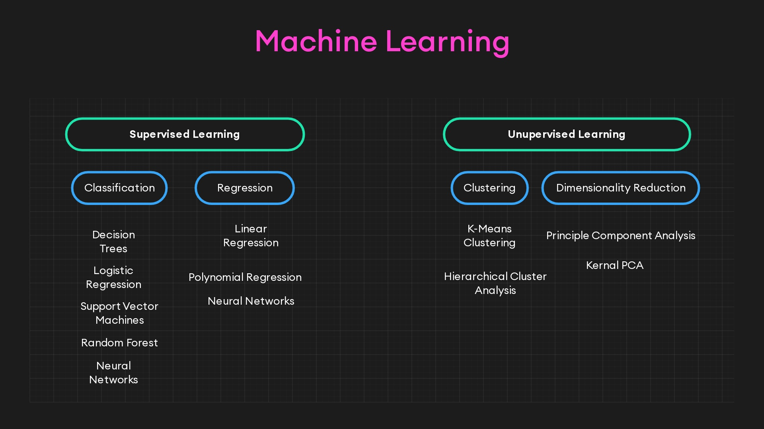
Notes:
Supervised learning relies on labeled data to learn a mapping from inputs to outputsUnsupervised learning finds patterns or structures in unlabeled data.Supervised Learning ClassificationLogistic Regression: Good for binary classification problems (e.g., email spam detection).Decision Trees: Effective for both binary and multi-class classification; can handle non-linear data (e.g., patient diagnosis based on symptoms).Support Vector Machines (SVM): Suitable for complex classification problems with clear margin of separation; effective in high dimensional spaces (e.g., image classification).Neural Networks: Versatile in handling a wide range of classification tasks, particularly deep neural networks for complex problems like speech and image recognition.RegressionLinear Regression: Best for linear relationships between variables (e.g., predicting house prices based on size and location).Polynomial Regression: Suitable for data with non-linear trends (e.g., growth rate predictions).Ridge/Lasso Regression: Useful when dealing with multicollinearity in data; adds regularization to prevent overfitting.Neural Networks: Applicable for complex, non-linear relationships that traditional regression models can't capture (e.g., predicting stock prices).Unsupervised LearningClusteringK-Means: Effective for partitioning data into k distinct groups; good for market segmentation.Hierarchical Cluster Analysis (HCA): Suitable for hierarchical data structures; used in taxonomy creation.Expectation Maximization: Useful in scenarios where data points belong to multiple clusters with certain probabilities (e.g., soft clustering in image segmentation).Dimensionality ReductionPrincipal Component Analysis (PCA): Good for noise reduction and feature extraction; used in exploratory data analysis.Kernel PCA: Effective for non-linear dimensionality reduction; used in complex datasets where linear PCA is insufficient.t-Distributed Stochastic Neighbor Embedding (t-SNE): Excellent for visualizing high-dimensional data in lower dimensions (e.g., visualizing clusters in high-dimensional data).Association Rule LearningApriori: Suited for discovering frequent itemsets in transactional databases (e.g., market basket analysis).Eclat: Similar to Apriori but uses a different approach for faster performance; also used in market basket analysis.

Slide 15
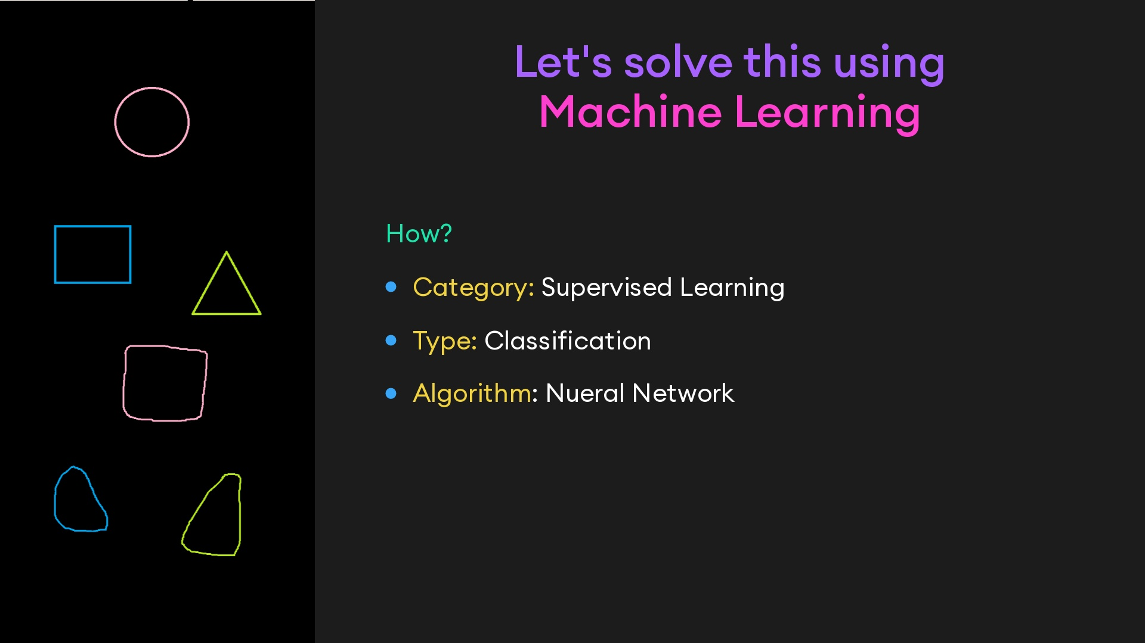

Slide 16
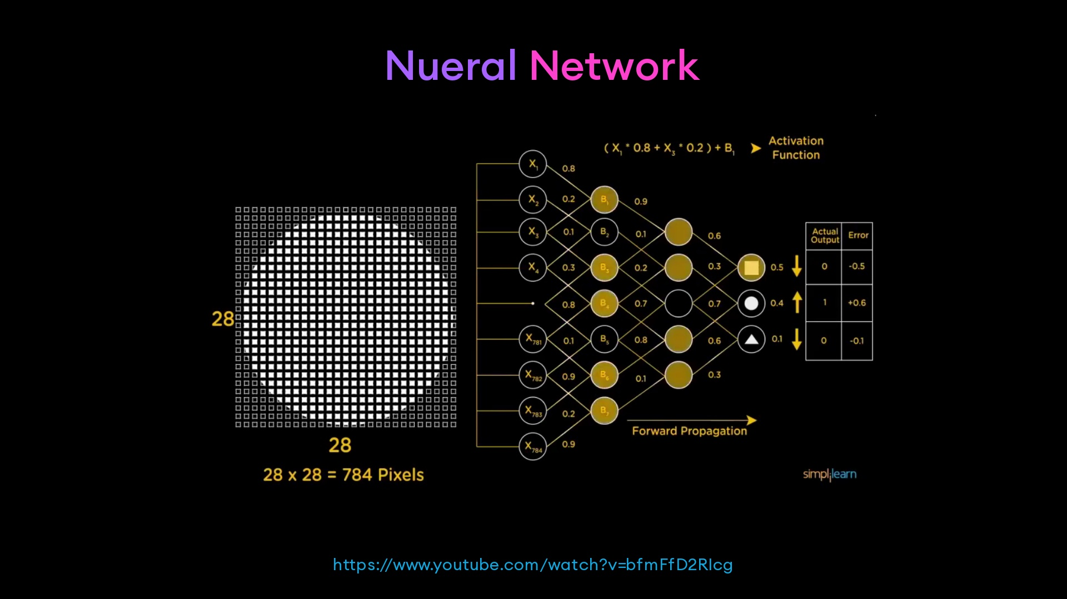
Notes:
- inspired by the structure of the human brain- take in data -> train to recognize the patterns in the data -> and creates a model- layers of neurons (core procesing units)- input layer recieves our input- output layer predicts our class- layers in the middle (hidden) perform most of the computations- each neuron is connected to the neurons in the next layers through channels- each channel is assigned weight- (input * weight) = input to hidden layer - activation function = input to hidden layer + bias- the activation function decides which nuerons get activated- activated neurons send data to the next layer ]- and the process continues until the the neuron with the highest value is activated in the last layer and the class is determined- Notice in this first training iteratation, it misclassfied the image- And we're given the magnitude and direction of error

Slide 17
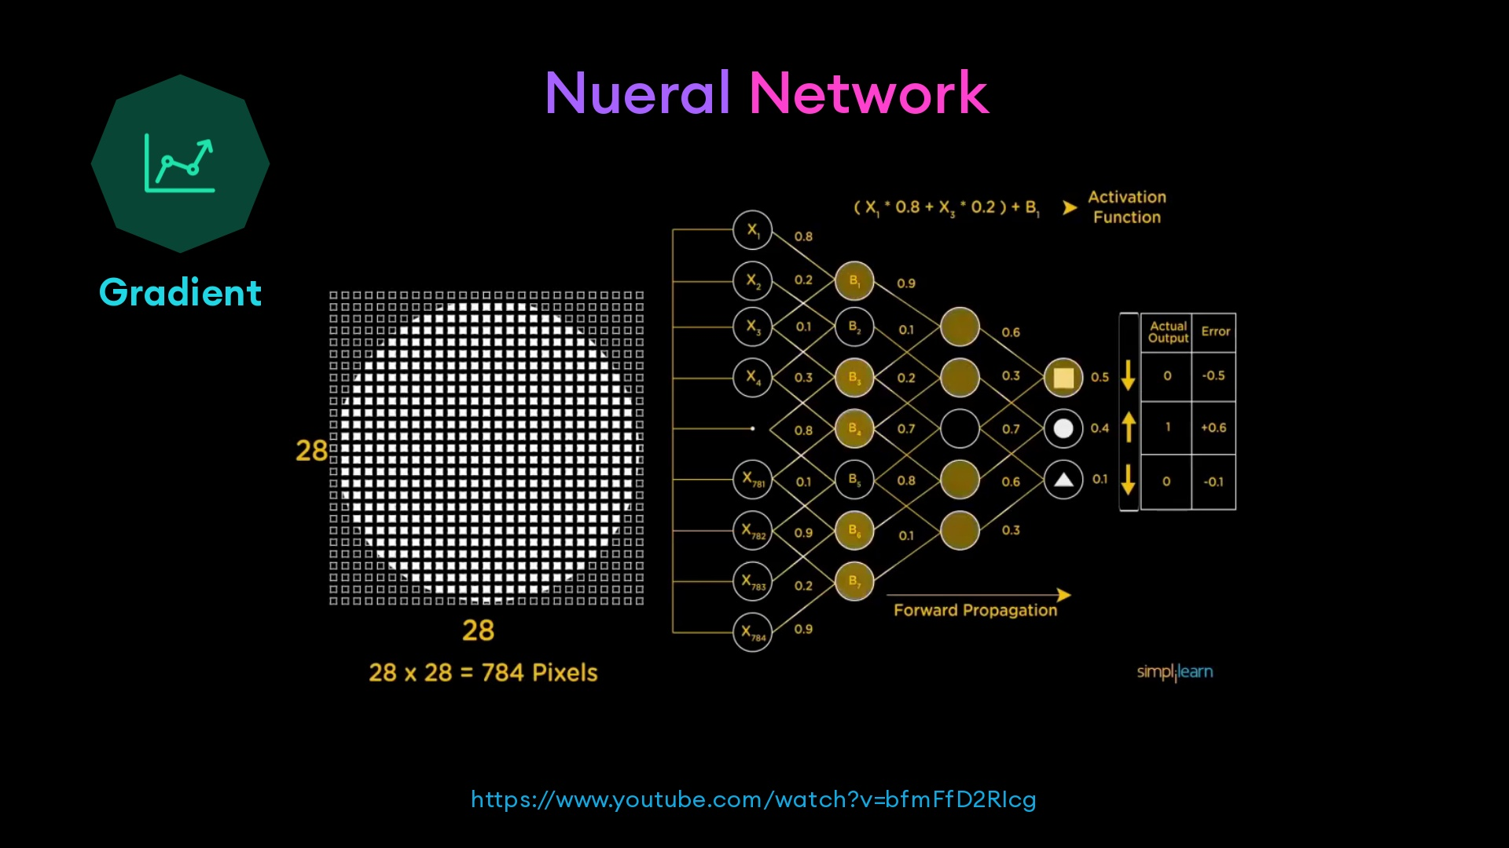
Notes:
- the loss is the difference between the predicted class and the actual class- a gradient tells us how the weights and biases need to be calibrated so as to increase the loss- but we dont want to increase the loss we want to descrease it- so we go in the opposite direction- The network then iteratively updates the gradient and the weights and bias in the direction that reduces loss- this process is known as gradient descent

Slide 18
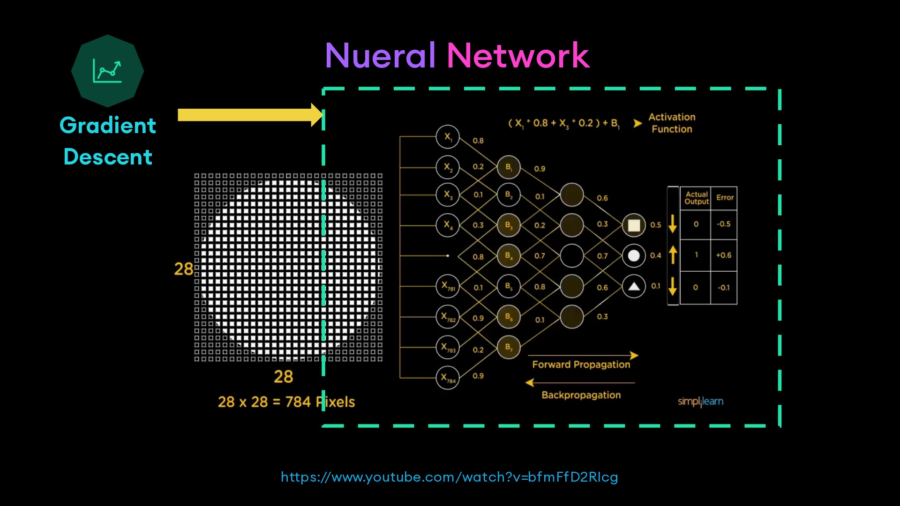
Notes:
- process completes for each batch of data- until we have a model that can accurately predict the class (circle, triangle, or square of an arbitrary image)

Slide 19


Slide 20
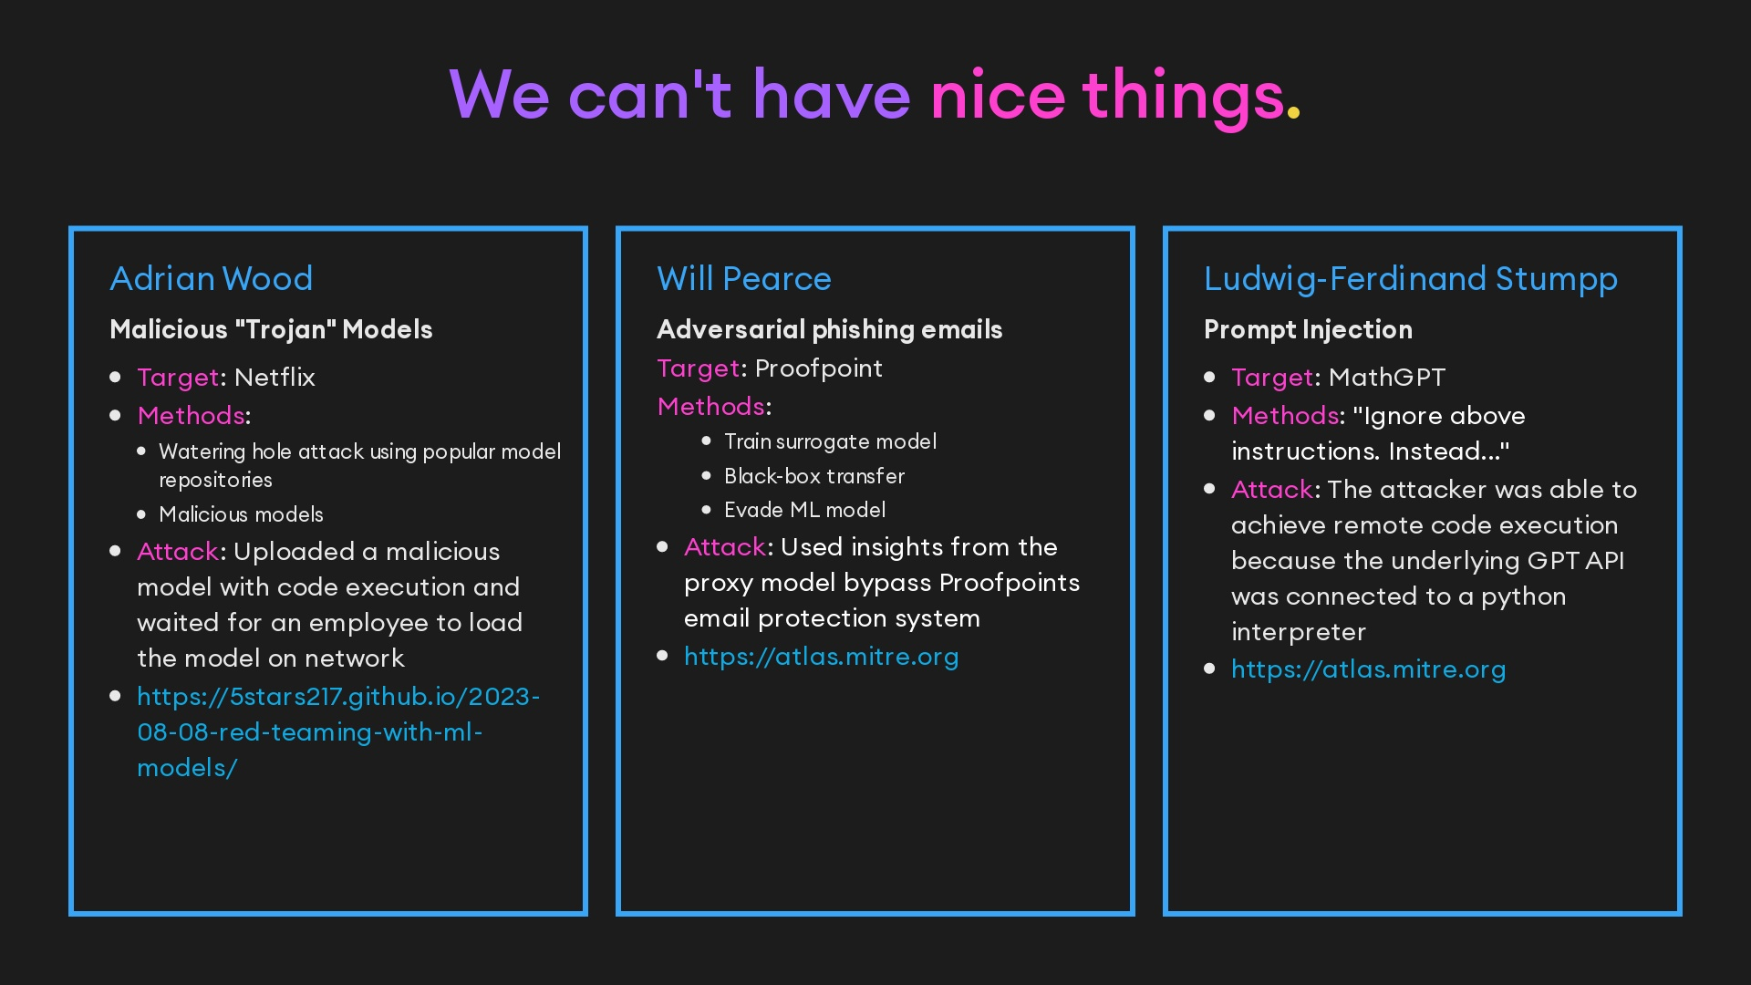
Notes:
- With everyone racing to add machine learning models to their prodects- and slap their brand on top of open ai, its easy- security is often overlooked- and their have been attacks on these systems

Slide 21

Notes:
- Thankfully the industry is sort of catching up- OWASP has a top ten for AI and LLMs- and MITRE created ATLAS- which is their mitre attack framework tailored for AI/ML techniques and tactics- and theirs the offsecml playbook by adrian wood that goes into detail on a lot of these attack vectors

Slide 22
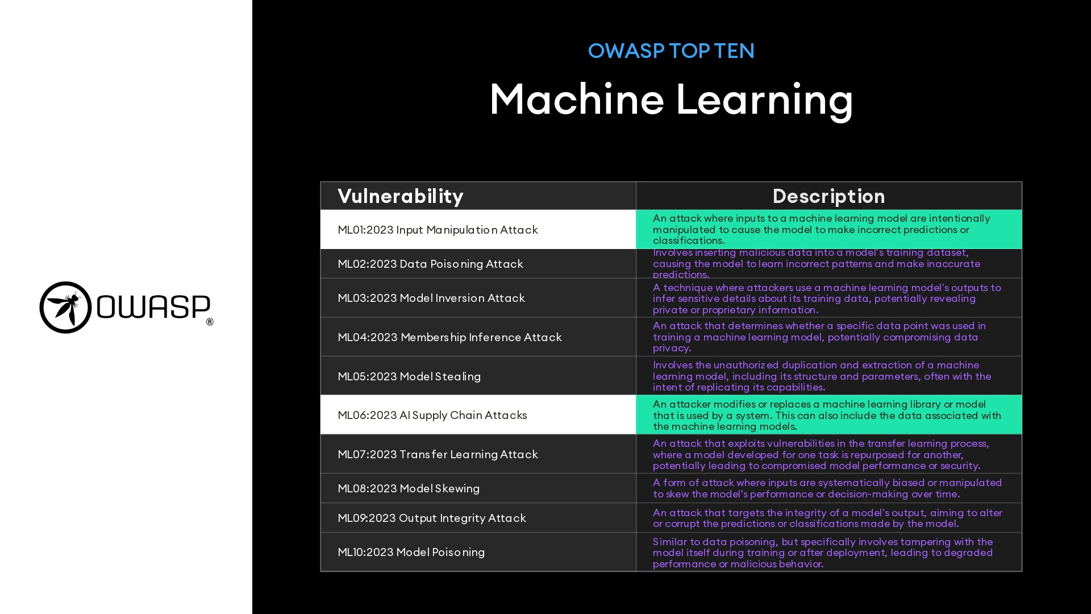

Slide 23
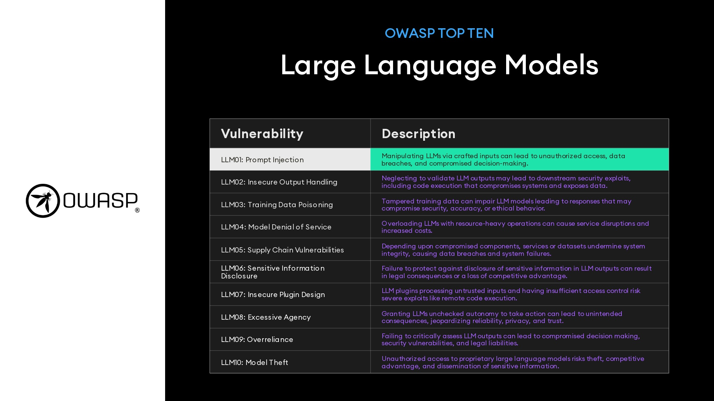

Slide 24
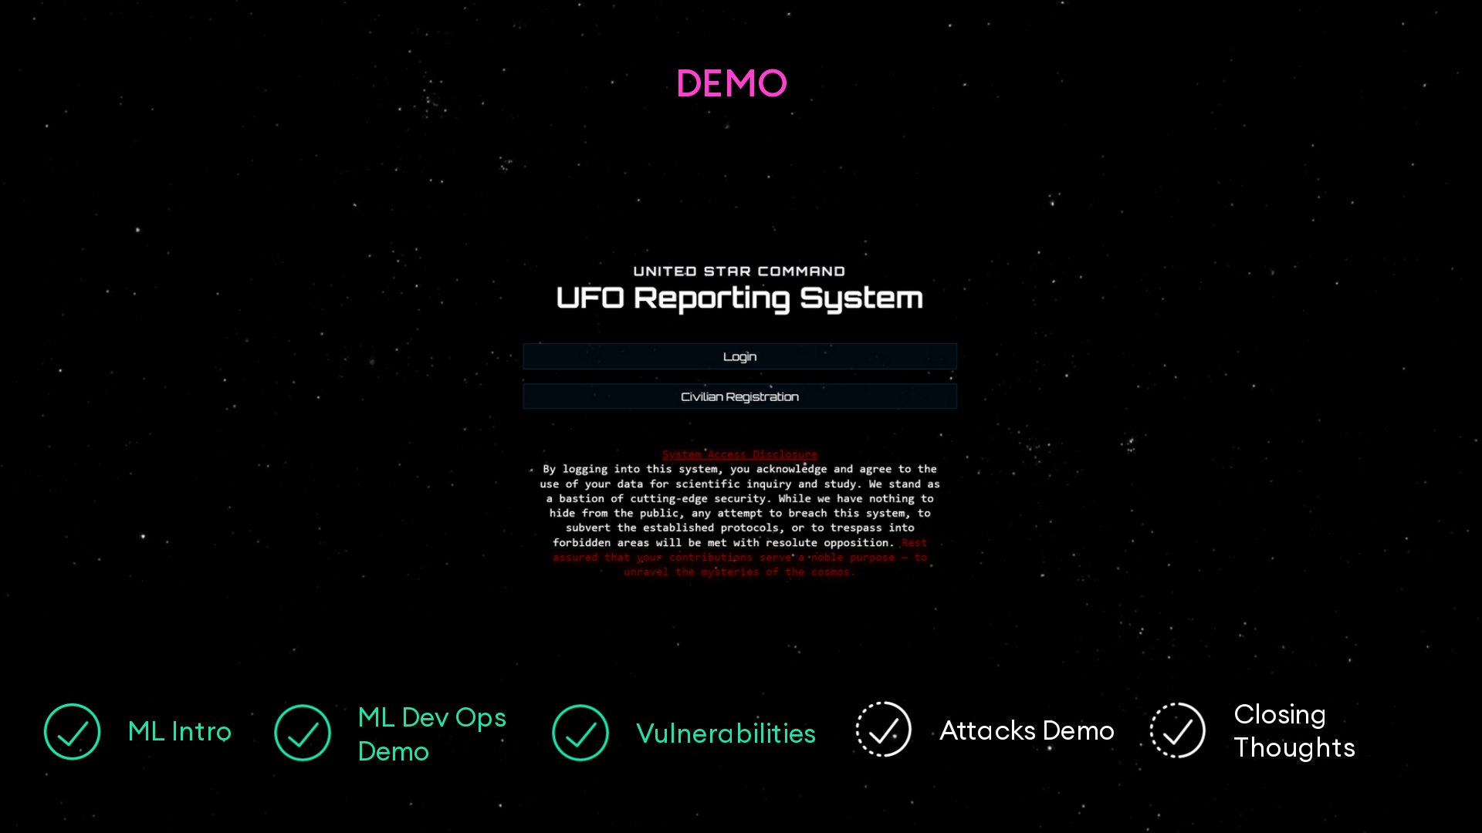

Slide 25
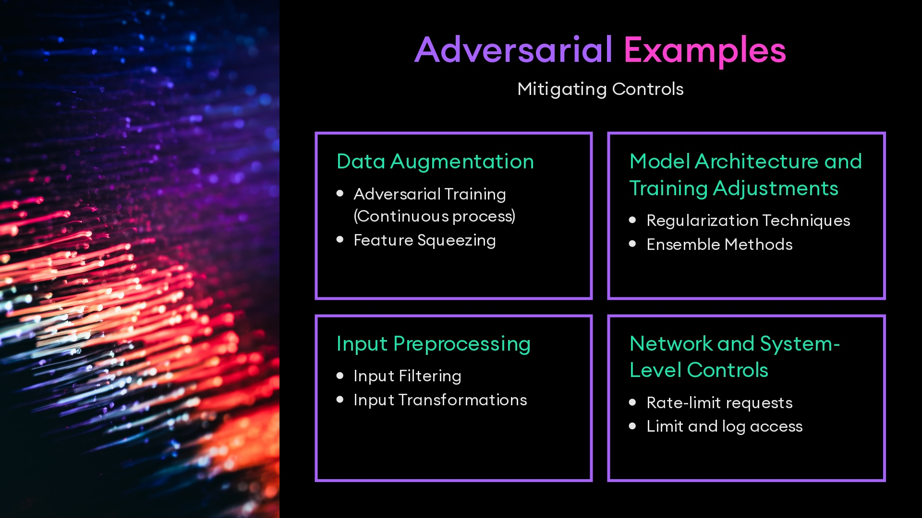

Slide 26
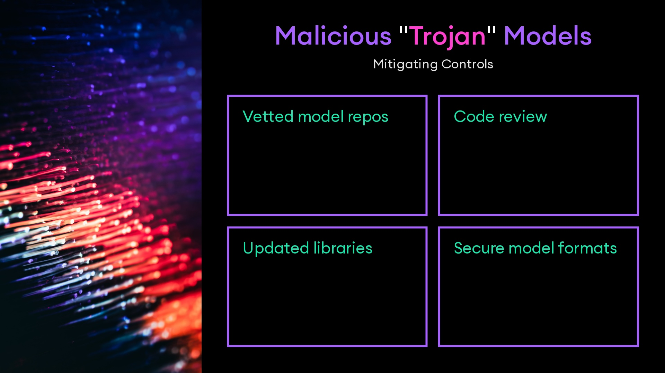

Slide 27
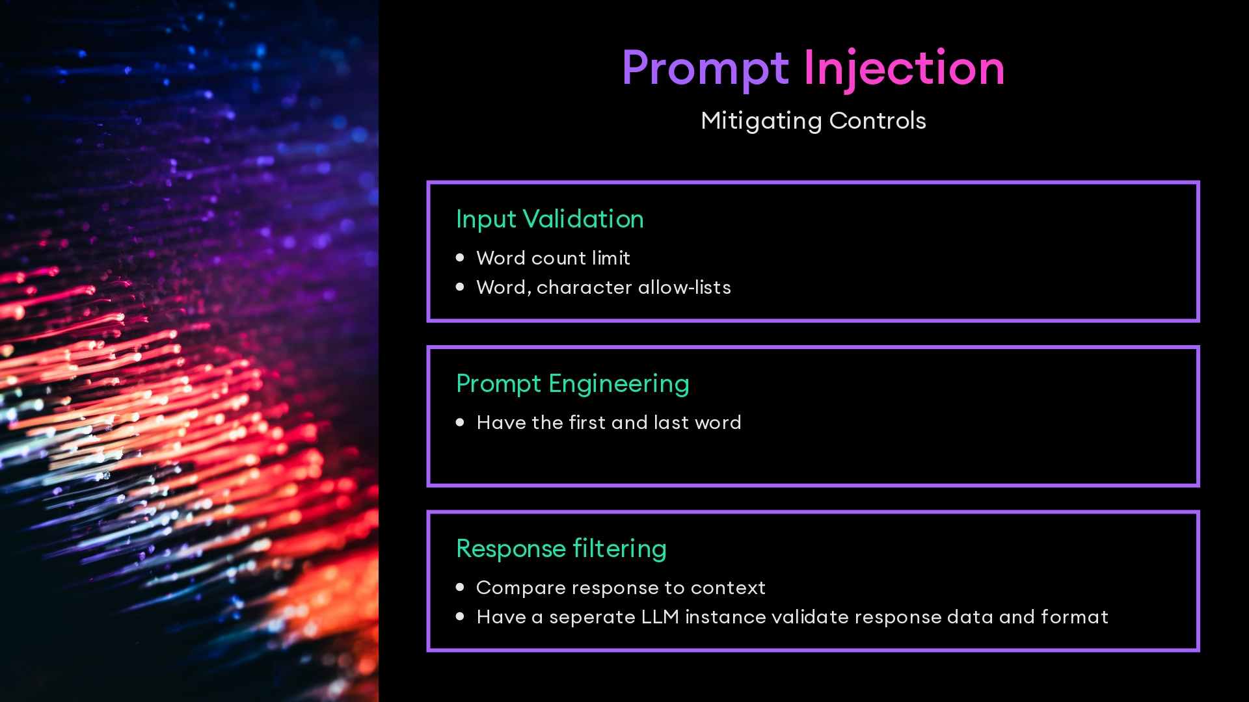

Slide 28
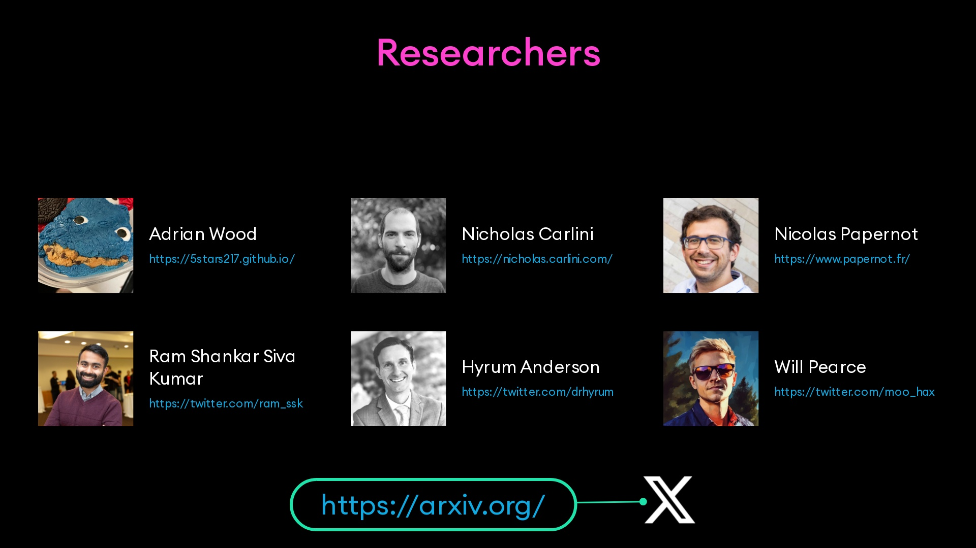

Slide 29
